Slide 1
Reversi (Othello)

Slide 2
Agenda
Introduction & Origin
Game Rules
Project Architecture
Software Development Life Cycle
Conclusion

Slide 3
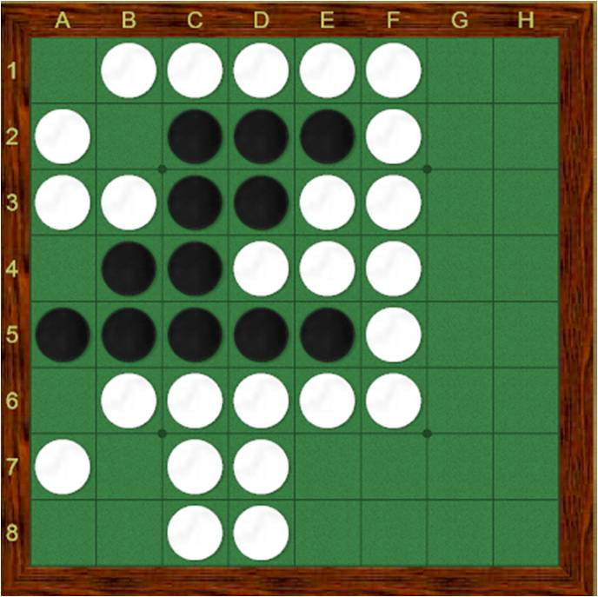
Introduction & History
Reversi, also known as Othello, dates back to the late 19th century. The game is believed to have been created around 1883 in England. Credit is often attributed to Lewis Waterman or Jhon W. Mollett, though the true origin remains debated. The name “Othello” was inspired by Shakespeare’s play due to the contrasting black and white pieces.

Slide 4
Game Rules
Game is played on an 8×8 board and starts with four coins placed at the center: two black and two white in diagonal arrangement.
Players take turns placing one coin of their color on an empty square.
A placed coin must flank opponent’s coins (horizontally, vertically, or diagonally) between the placed coin and another coin of the same color.
All opponent’s coins that fall between two matching coins are flipped, becoming the color of the player who made the move.
A move is only legal if it flips at least one opponent piece, otherwise the player can’t place their coin.
If a player has no legal move, they must pass, and the opponent continues.
If neither player can make a move, typically when the board is full or no legal move exists, the game ends.
The player with the majority of colored coins at the end wins, counted by total flips made throughout the game.
Corner positions are the most advantageous, because coins placed there cannot be flipped later, influencing strategic play.

Slide 5
Project Architecture
Domain
Pure domain logic: entities, rules, board, types, exceptions
Applications
Use cases. Orchestrates domain and calls ports (interfaces).
Ports
Define interfaces (abstract base classes) the application depends on — UI, AI, persistence.
Adapters
Concrete implementations of ports. Examples: ConsoleUI, PygameUI, RandomAI, MinimaxAI.
Infrastructure
Logging, configuration, DI (Dependency Injection) wiring.
Launchers
Compose dependencies and start the app.

Slide 6
Software Development Life Cycle

Slide 7
1. Requirement Analysis
Functional Requirements:
  System must allow two players to play Reversi with valid move enforcement.
  Game must calculate valid moves, flips, and detect end-of-game state.
  Provide visual interaction (Console first, GUI later using Pygame).
  Allow enabling Player vs Player initially; later support AI vs Player.
  Game must expose separate interfaces for UI to maintain portability.
Non-Functional Requirements:
  Clean and extensible architecture.
  Versioning through Git.
  Structured modules for future scalability:
    AI strategy injection
    Logging and persistence
    GUI implementation with minimal disruption
  Code must be testable at domain and application layers.

Slide 8
2. System Design & Architecture
Domain
Entities
Rule Engines
Application
Game Engine
Turn Manager
Ports
User Interface Port
Value Objects
Exeptions
Use Cases
AI Player Port
Adapters
Console UI
Graphical UI
Web UI
Infrastructure
Logger
Configuration
Data Storage
Launchers
Console
Graphical
Web

Slide 9
3. Implementation Phase
Domain
Create Entities
Implement Core Rules
Application
Implement Game Engine
Add use-cases
Ports
Add different ports
Adapters
Infrastructure
Add Configuration
Implement Data Storage Strategies
Add different adapters for console/gui/web
Launchers
Add different launchers for console/gui/web

Slide 10
4. Testing Strategies
Domain
Rules & Validation
Application
Turn Flow & Game Initialization
Adapters
Rendering Utilities
Infrastructure
Flipping & Game-end logic
User Input Parsing
Logging
Configuration
Launchers
Rendering
Control/Data Flow
Error Propagation

Slide 11
5. Maintenance and Scalability
Add difficulty-based AI engines into the AI Ports:
  Easy – Random Choice
  Medium – Greedy Choice
  Hard – Minimax Algorithm
Add persistence (save/load feature)
Add logging-based analytics
Release web-based UI (adapter for FastAPI) [Optional]
Integration with leaderboard service

Slide 12
Final tips & takeaways

Slide 13
Revisiting the Game Rules
Reversi is a game of territory control through strategic flips.
Every legal move must capture at least one opponent’s coin.
Board awareness—especially edges and corners—directly influences winning potential.
Simplicity at the rule level opens the door for deeper strategic computation.

Slide 14
Recap of Project Architecture
We established a modular structure that isolates the core game logic from UI and infrastructure.
Domain rules remain platform-agnostic, ensuring minimal rework as features evolve.
Ports and Adapters give the project long-term flexibility:
  Adding a GUI without modifying logic.
  Extending AI strategies.
  Enabling persistence in later phases.
The architecture reflects real-world enterprise structure where interfaces contractually bind systems while allowing independent evolution.

Slide 15
SDLC Summary
Requirements were modeled for both initial release and scalable expansion.
System design aligned with separation of responsibilities, safety of changes, and testability.
The implementation plan follows staged evolution:
  First console interaction for correctness,
  Second GUI for richer UX, and optionally web.
Testing focuses on correctness of rules before presentation refinements are made.
Maintenance phase ensures the team can iterate confidently and extend features over time.

Slide 16


Thank you
Talha Ahmad & Areeb

